Slide 1
Real-Time Hand Gesture Recognition for Human-Computer Interaction
Mohan Vamsi Olipi
904047187
Git Hub Link

Slide 2
Why Is Real-Time Gesture Recognition is Important?
Evolution of Human-Computer Interaction (HCI):
  Traditional input devices (mouse, keyboard) are becoming outdated.
  Gesture recognition provides a natural and intuitive way for humans to interact with technology.
Touchless Interaction:
  Enables hands-free control, improving accessibility and hygiene (e.g., smart home, virtual reality).
Improved User Experience:
  Users interact with devices in a more natural and fluid way, similar to interacting with people.
Faster and More Intuitive:
  Allows quicker responses and commands compared to traditional input methods.

Slide 3
Project Objective
Goal:
Build a real-time hand gesture recognition system that provides efficient control for various applications (HCI, VR, Smart Homes).
Achieve high accuracy and low latency (<33ms per frame).
Key Challenges Addressed:
Traditional methods are not fast enough for real-time applications.
Focus on achieving high accuracy with low inference time, ideal for resource-constrained environments.

Slide 4
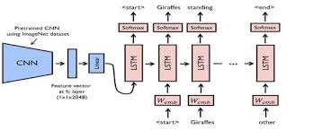
Model Overview
Hybrid CNN-LSTM Architecture:
CNN for spatial features: Efficient extraction of spatial features like hand shape and gesture context.
LSTM for temporal features: Model the sequence of gestures to understand dynamic hand movements.
Flow of the Model:
Input: Video → Frames → CNN extracts features → LSTM models sequences → Output: Gesture Class Prediction.

Slide 5
Data Preprocessing
Dataset: Jester Dataset from Kaggle
Size: 148,092 videos, 27 gesture classes.
Gestures: Swiping, zooming, pointing, etc.
Data Conversion: Videos are split into individual frames (224x224) for processing.
Preprocessing Steps:
Frame extraction from videos.
Normalization: Convert pixel values to a 0-1 range for better model performance.
One-hot encoding for gesture labels (27 classes).

Slide 6
CNN-LSTM Model
CNN Backbone: MobileNetV2
Lightweight, efficient architecture for fast processing.
Layers: Convolutional layers for feature extraction, pooling layers for spatial dimension reduction.
LSTM Layer:
Captures the sequence of gestures across frames.
Helps with context understanding (e.g., a swipe gesture is different from a zoom gesture).
Output Layer:
Softmax layer with 27 neurons, each representing one gesture class.

Slide 7
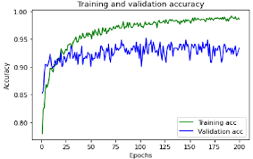
Model Training
Training Process:
Split dataset: 80% training, 10% validation, 10% test.
Optimizer: Adam optimizer for faster convergence.
Loss Function: Categorical cross-entropy.
Metrics: Accuracy, Precision, Recall, and F1-Score.
Expected Results:
Training accuracy: >90%.
Inference speed: <33ms per frame.

Slide 8
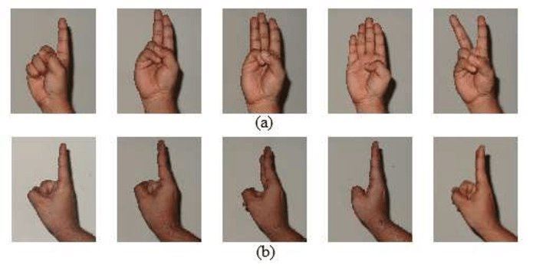
Results and Evaluation
Accuracy: Measures the correct predictions vs total predictions.
Precision, Recall, F1-Score: Assess the model's performance for each gesture class.
Model Comparison:
Compare the CNN-LSTM hybrid model's performance (accuracy and inference time) with traditional CNN models (like MobileNetV2 without LSTM).

Slide 9
Use Cases
Virtual Reality (VR):
Gesture-based control of virtual objects (e.g., controlling a VR game environment with hand movements).
Smart Home Devices:
Control lights, fans, music, etc., through hand gestures.
Example: "Swiping" gestures to change TV channels or adjust the thermostat.
Human-Computer Interaction (HCI):
Touchless computer control for accessibility, making it easier for people with disabilities.

Slide 10
Challenges & Future Work
Challenges:
  Real-Time Processing: Maintaining fast inference times on resource-constrained devices like smartphones or edge devices.
  Environmental Factors: Handling gestures in different lighting conditions or noisy backgrounds.
Future Work:
    Improve performance with more diverse training data.
  Handle multi-hand gestures and improve gesture recognition accuracy in complex scenarios.
  Expand to mobile devices with optimized model architectures for mobile inference.

Slide 11
Conclusion
Real-Time Performance: The model successfully recognizes hand gestures in real-time with an inference time of less than 33 ms per frame, making it suitable for applications like human-computer interaction (HCI) in virtual reality and smart home systems.
High Accuracy: The hybrid CNN-LSTM model achieves an accuracy of over 90%, demonstrating robust performance in dynamic gesture recognition.
Seamless Integration: By incorporating both spatial and temporal features, the model provides a seamless and intuitive gesture control system, eliminating the need for physical touch in interactive systems.
Scalability: The approach is highly scalable and can be adapted to different gesture datasets and real-time applications with minimal changes.
Future Improvements: There is potential to enhance the model by incorporating more gesture categories, improving training with more diverse datasets, and optimizing for deployment on edge devices with limited computational resources.

